Slide 1
DEPARTMENT OF COMPUTER APPLICATION
2026-27
JSS SCIENCE AND TECHNOLOGY UNIVERSITY
BCA MINI PROJECT SRS EVALUATION
JOBGUARD AI
“Intelligent Detection and Risk Assessment of Fraudulent Online Job and Internship Postings”
Presented by:
Charan M
USN:01JST24UBC024
Chethan Kumar L E
USN:01JST24UBC025
Department of Computer Applications
JSS Science and Technology University
Project Guide:
Dr. C. S. Santhosh
Assistant Professor
Department of Computer Applications
JSS Science and Technology University

Slide 2
CHAPTER 1: DATASET AND PREPROCESSING
Study Area
Datasets
Processing
• Cybersecurity problem: fraudulent online recruitment.
• Inputs include job posts, recruiter messages, links and employer evidence.
• Goal: detect risk using multiple signals, not one keyword.
• EMSCAD → job-posting text scam classification.
• PhiUSIIL → structural URL phishing classification.
• Live user inputs are analyzed at runtime.
• Text, URL and rule/verification features.
• Cleaning → normalization → feature extraction.
• Post-processing converts evidence into explainable findings.
2

Slide 3
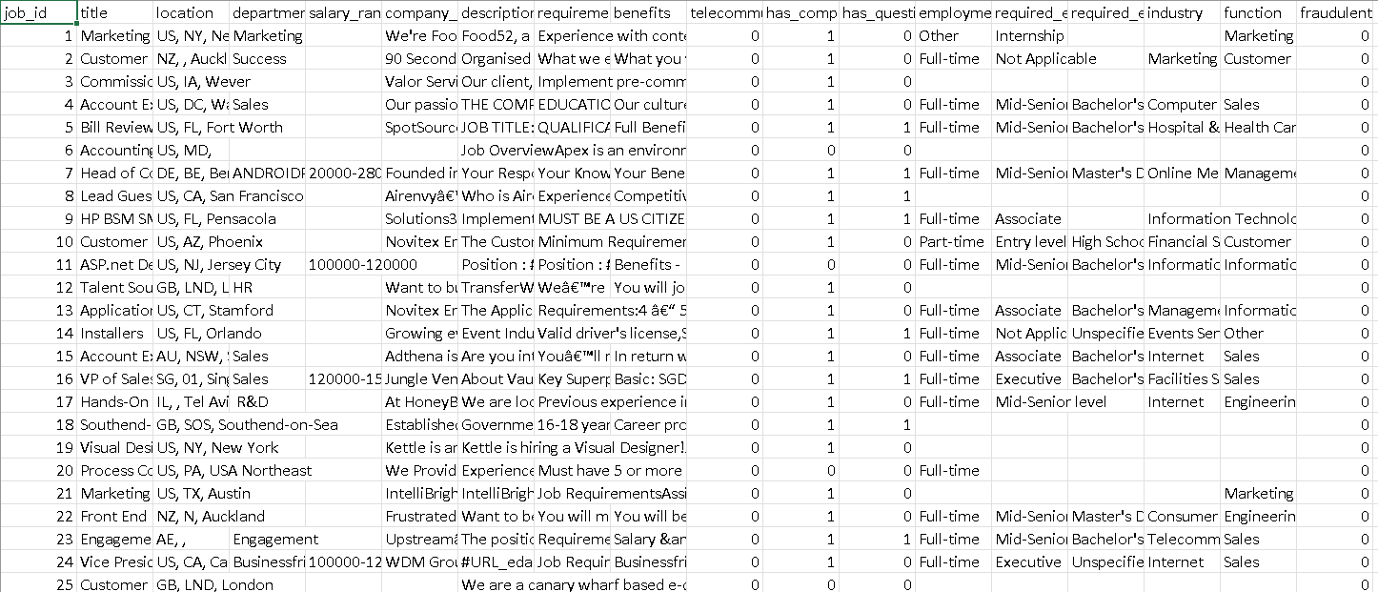
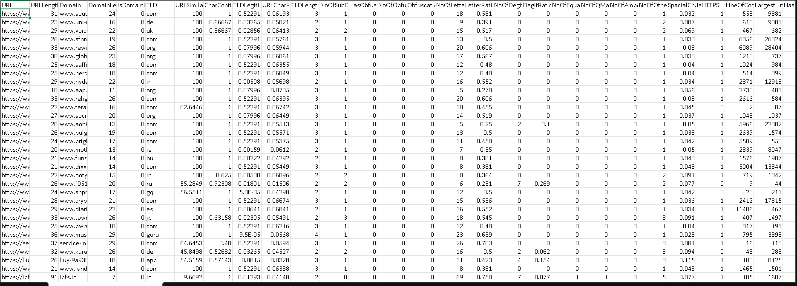
DATASET SAMPLE AND DESCRIPTION
EMSCAD — Fake Job Postings
PhiUSIIL — Phishing URLs
17,880 job postings
17,014 legitimate + 866 fraudulent
Used for TF-IDF + Logistic Regression
235,795 URL records
134,850 legitimate + 100,945 phishing
54 documented features → 18 retained URL features
Representative sample format
3

Slide 4
WHY TWO DATASETS?
EMSCAD — Recruitment Text
PhiUSIIL — URL Risk
Why Combine Them?
1.1 Study Area
1.2 Datasets
1.3–1.4 Processing
• Cybersecurity problem: fraudulent online recruitment.
• Inputs include job posts, recruiter messages, links and employer evidence.
• Goal: detect risk using multiple signals, not one keyword.
• EMSCAD → job-posting text scam classification.
• PhiUSIIL → structural URL phishing classification.
• Live user inputs are analyzed at runtime.
• Text, URL and rule/verification features.
• Cleaning → normalization → feature extraction.
• Post-processing converts evidence into explainable findings.
• Contains fake and legitimate job postings.
• Captures scam language and recruitment patterns.
• Supports TF-IDF + Logistic Regression.
• 17,880 total job postings.
• Large phishing / legitimate URL corpus.
• Captures structural and lexical URL patterns.
• 18 URL features retained for runtime analysis.
• 235,795 total records.
• A job scam may look normal in text but use a malicious link.
• A suspicious URL alone does not prove recruitment fraud.
• Combining evidence gives a broader risk picture.
4
4

Slide 5
FEATURES & PREPROCESSING
Text Features
URL Features
Pre/Post-processing
• TF-IDF n-gram representation.
• Captures informative words and phrases.
• 12,000 vocabulary features used by the text model.
• 18 structural / lexical URL features retained.
• Length, subdomains, obfuscation, digits, special characters.
• HTTPS and domain structure are included.
• Clean and normalize input.
• Validate and extract features.
•Generate predictions and evidence.
•Combine findings for final risk output.
5

Slide 6
FEATURE GROUPS
TEXT FEATURES
URL FEATURES
RULE + VERIFICATION
1.1 Study Area
1.2 Datasets
1.3–1.4 Processing
• Cybersecurity problem: fraudulent online recruitment.
• Inputs include job posts, recruiter messages, links and employer evidence.
• Goal: detect risk using multiple signals, not one keyword.
• EMSCAD → job-posting text scam classification.
• PhiUSIIL → structural URL phishing classification.
• Live user inputs are analyzed at runtime.
• Text, URL and rule/verification features.
• Cleaning → normalization → feature extraction.
• Post-processing converts evidence into explainable findings.
TF-IDF / n-grams
Examples:
• unusual salary claims
• fee / payment language
• urgency or pressure
• suspicious recruitment wording
18 retained structural features
Examples:
• URL/domain length
• subdomains
• obfuscation
• digits / special characters
• HTTPS
Deterministic evidence
Examples:
• advance-fee requests
• Telegram / WhatsApp-only contact
• suspicious payment methods
• company / vacancy verification
• typosquatting similarity
6
6

Slide 7
CHAPTER 2: MODELS AND ALGORITHMS
1
2
3
Rule-Based
Scam Detection
TF-IDF
Text Representation
Logistic Regression
Classifier
4
URL Feature
Extraction
Together: classify text + assess URLs + detect deterministic scam indicators.
7

Slide 8
WHY MULTIPLE MODELS?
JOB TEXT
TF-IDF
+ Logistic
URL
FEATURES
Gradient
Boosting
RULES +
VERIFY
Key advantage
Different signals detect different types of fraud.
JobGuard AI does not depend on a single model. It combines text analysis + URL analysis + scam rules + verification to produce a more reliable and explainable risk assessment.
“One model can miss a signal — multiple independent signals provide stronger evidence.”
8
8

Slide 9
TEXT CLASSIFICATION MODEL
Job / recruiter text
TF-IDF
Vectorization
Logistic
Regression
Legitimate /
Fraudulent
Core idea
Documented setup
TF-IDF weights terms by importance in the posting. Logistic Regression converts the vector into a fraud probability.
EMSCAD: 12,000 TF-IDF features; stratified 80:20 split for training and held-out testing.
Simplified equation: P(y=1|x) = 1 / (1 + e⁻ᶻ)
9

Slide 10
URL ANALYSIS & VERIFICATION
HistGradientBoosting
Levenshtein + Rules
URL Feature Extraction
• 18 retained features.
• URL/domain length and subdomains.
•Obfuscation, digits, special characters.
• HTTPS and lexical structure.
• Learns non-linear relationships in URL features.
• PhiUSIIL: 80% train / 20% test.
• Produces URL phishing risk.
• Measures domain-string similarity.
• Flags possible typosquatting.
• Rules detect fees, urgency, payment requests and suspicious channels.
Output: URL risk + similarity evidence + rule indicators
10

Slide 11
CHAPTER 3: PROPOSED METHODOLOGY
1. Input
Job text
URL
Company / recruiter
2. Validate
Clean + normalize
Extract entities
3. Analyze
Text model
URL model
Rules
4. Verify
Company / vacancy
Payment evidence
5. Fuse
Combine evidence
0–100 risk
6. Explain
Threat tier
Reasons + guidance
Intermediate evidence retained
Text prediction • URL risk • rule hits • verification state • similarity / typosquatting • contextual reasoning
11

Slide 12
RISK FUSION
Text Risk
URL Risk
Rule / Payment
Risk
Verification /
Context
↓
WEIGHTED EVIDENCE FUSION
Final Risk Score: 0–100
Lower score → lower observed risk | Higher score → stronger fraud evidence
12
12

Slide 13
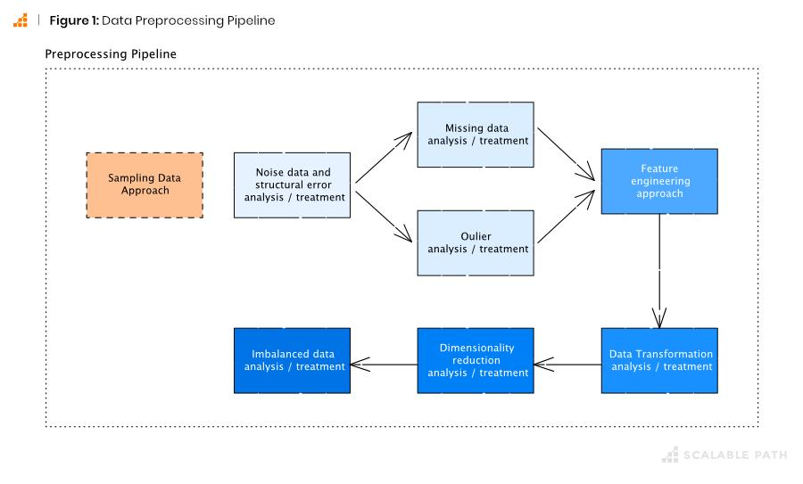
INPUT → PROCESSING → OUTPUT
INPUT
MAJOR PROCESSING
FINAL OUTPUT
• Job description / recruiter message
• Company and role
• Recruiter contact
• Application URL
• Salary / payment details
• Documents or screenshots
• Validation & extraction
• TF-IDF + Logistic Regression
• 18-feature URL analysis
• HistGradientBoosting
• Scam/payment rules
• Verification + contextual reasoning
• 0–100 risk score
• Threat tier
• Evidence / red flags
• Verification state
• Explanation
• Candidate safety guidance
13

Slide 14
MODEL TRAINING & PERFORMANCE METRICS
Training & Testing
Feature Selection
EMSCAD: 17,880 → 14,304 train / 3,576 test
PhiUSIIL: 235,795 → 188,636 train / 47,159 test
Both use stratified 80:20 evaluation.
EMSCAD text: 12,000 TF-IDF vocabulary features
PhiUSIIL: 18 URL features retained; 36 dataset columns excluded from the runtime URL model.
Recall
Precision
F1-score
TP / (TP + FN)
TP / (TP + FP)
2PR / (P + R)
Measures detection coverage
Measures alert correctness
Balances precision & recall
14

Slide 15
WHY JOBGUARD AI? — PROJECT JUSTIFICATION
It is a recruitment-focused, multi-signal risk assessment system for job seekers.
1.1 Study Area
1.2 Datasets
1.3–1.4 Processing
• Cybersecurity problem: fraudulent online recruitment.
• Inputs include job posts, recruiter messages, links and employer evidence.
• Goal: detect risk using multiple signals, not one keyword.
• EMSCAD → job-posting text scam classification.
• PhiUSIIL → structural URL phishing classification.
• Live user inputs are analyzed at runtime.
• Text, URL and rule/verification features.
• Cleaning → normalization → feature extraction.
• Post-processing converts evidence into explainable findings.
NOT JUST PHISHING DETECTION
NOT JUST A KEYWORD FILTER
NOT JUST A BLACK-BOX AI
• Phishing systems mainly judge URLs.
•JobGuard also analyzes job-posting language, recruiter behavior and payment requests.
• Recruitment scams can exist even without an obvious phishing URL.
• Uses TF-IDF + Logistic Regression for text.
•.Uses 18 URL features + HistGradient Boosting
• Adds deterministic scam and payment rules.
• Keeps intermediate evidence.
• Includes company / vacancy verification.
• Produces reasons, threat tier and safety guidance with the 0–100 score.
PROJECT VALUE: Detect + Correlate + Verify + Explain + Protect the Job Seeker
15
15

Slide 16
Thank You

